Slide 1
Introduction
What is Wordpress?
Benefits of Wordpress
How to install

Slide 2

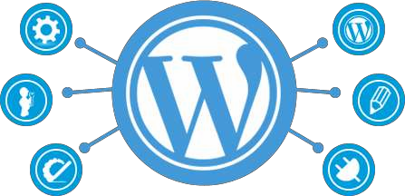
Introduction
WordPress is an online, open source website creation tool written in PHP. But in non-geek speak, it’s probably the easiest and most powerful blogging and website content management system (or CMS) in existence today.

Slide 3
What is Wordpress?
WordPress is highly customizable, and has literally thousands of plugin pieces of software so you can use your site for just about anything.
If you’re ever curious about who uses WordPress, head on over to the WordPress site showcase and you’ll be impressed by the number of well-known sites and famous people using WordPress to power their websites.

Slide 4
What is Wordpress?
You’re in good company if you use WordPress to publish on the web. Many famous blogs, news outlets, music sites, Fortune 500 companies and celebrities are using WordPress. For example, famous blogs like Mashable and TechCrunch are both on WordPress.

Slide 5
Benefits of Wordpress
WordPress is highly customizable, and has literally thousands of plugin pieces of software so you can use your site for just about anything.
Since WordPress is open source, it’s free. That’s always a bonus. And again, because it’s open source, it also has a thriving community of developers constantly improving the software and creating plugins to expand the software.

Slide 6
Here are some of the benefits of using WordPress:
Software is Free
Easy to use
Control is in your hands
SEO Advantages & SEO Friendly
Very Large Community Support

Slide 7
Software is free
How many times have you been given something for free that is fully functional and ready to use?
And if you want to upscale your site a little with premium themes and plugins, you’re still going tosave tons of money over what you would pay for a custom designed site.
Easy To Use
If you can send an email, use Microsoft Word, or set up a Facebook account, then you can use WordPress. In other words, if you’ve already used a computer, chances are you are already skilled enough for the WordPress basics. And even better, it’s hard to mess it up. You can easily add and delete pages and posts without accidentally messing up the overall design of your site.

Slide 8
Control is in your Hands
Owning your own site, and being able to make changes to it yourself, is the ultimate in online freedom. You’re in control of your site — and your wallet.
SEO Advantages & SEO Friendly
Search engines love sites that are easy to index and that have frequently updated
content. That’s where blogging comes in to play so nicely. Just by running your business or personal site and communicating with your readers in a way that’s natural to you, you’ll be producing fresh,relevant content the search engines can’t wait to get ahold of.

Slide 9
Very Large Community Support
WordPress isn’t just a software, it has become a community. Some might even say a
movement.
They are informal,community -organized events put together by other WordPress users just like you. You’ll meet people of all backgrounds, ages, and nationalities at WordCamps
. Plus, there are thousands of people and hundreds of resource and tutorial sites set up just to help you with your WordPress site.

Slide 10
How to install
Step 1: Install Local server (XAMPP Or WAMP)
Step 2: Start Server
Step 3: Copy Wordpress package from source and paste in www Directory. Step 4: Open PHP My admin & create database
Step 5: Open wordpress package in browser (localhost/your folder name), Configure according to your database name & password.

Slide 11
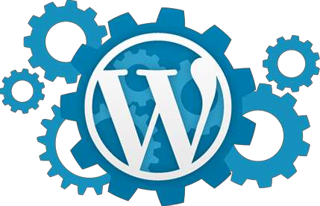
How to install
Step 6: Run & Install
Step 7: Login in Admin Panel (localhost/your folder name/ wp-login.php) Step 8: Visit front site and you have successfully installed your wordpress.

Slide 12


